Slide 1
Session 0 - Introduction
Deividas Skiparis

Slide 2
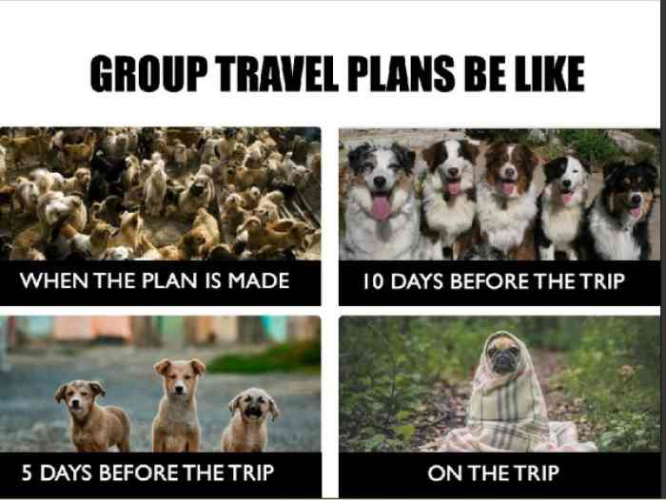

Slide 3
Agenda
About this club and what to expect
Get to know the hands-on project
Topics we will learn in the next few weeks
Install required software
Get to know your expectations

Slide 4
About AI Club
Initiative to create community of people interested in AI topics
First iteration will be closed to TWers. The plan is to open it up to public in the future when the club matures
Aimed at people with little or no experience in AI
People with experience in AI should step forward and offer to lead sessions on some topics. Best way to learn is to teach

Slide 5
Format
Next 8-9 weeks will be the first iteration
We have problem at hand, which we will try to solve using by stepping into the shoes of a Machine Learning engineer.
Every week we will address a topic which will help us to get towards the final goal.
Sessions will be run every Wednesday at 17:30 - 19:00.
20-30 mins of theory
>60mins of practical

Slide 6
Problem at hand
We will try to solve Kaggle competition: Carvana - Don't Get Kicked
In order to evaluate how well we are doing, we will use the official Kaggle API and Kaggle competition submission

Slide 7
Theory - 1st iteration
Sessions:
Introduction to course and setup
Data analysis and clean-up
Variable importance
Data augmentation
Linear/polynomial regressions and Random forest
Artificial neural networks (ANNs)
Automatic deployment pipeline for ML models
AWS for Artificial Intelligence

Slide 8
Give feedback
Although we have pre-defined topics we will learn, the list is not definitive. We will adapt to the needs of the club. For this reason it is super important to give feedback
We will have a feedback board for AI club, available throughout the week. Positive reinforcement as well constructive feedback are super important.

Slide 9
Practical
Let’s make the practical as self-organising as possible:
Work as you feel more comfortable (alone, in groups)
If working in groups, everyone should have work on their individual machines
Help others. The chain is as strong as its weakest link. Finished your work earlier? See if there is anyone stuck…

Slide 10
Get your machine ready
Install Python 3.6.8.
Q: Why not 3.7.x? A: Because last time I used P3.7.x with Keras, it had issues. We will most likely use Keras in the future, so to avoid having an issue with this later.
Create virtual environment
pip install virtualenv
virtualenv -p python3.6 envname
source envname/bin/activate

Slide 11
Get your machine ready
Install Kaggle API
pip install kaggle
Get data
https://www.kaggle.com/c/DontGetKicked/data

Slide 12
First try
Let’s attempt to use Kaggle API in order to submit our results for evaluation.
Check My Submissions section in https://www.kaggle.com/c/DontGetKicked/
Copy submission command into the terminal kaggle competitions submit -c DontGetKicked -f submission.csv -m "Message"
Use downloaded sample submission csv file to submit
Check My Submissions section for the evaluation -------------- IF YOU GET UNAUTHORIZED ERROR -----------------
Create Kaggle API token in Account Settings in Kaggle
Place the downloaded file in ~/.kaggle folder
Try submitting again

Slide 13
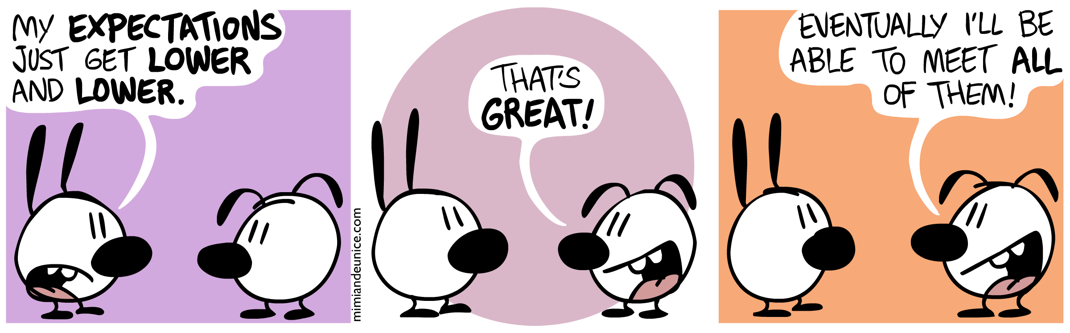
Expectation

Slide 14

Questions

